Slide 1
CSE 331 Project
Presentation
Parinda Rahman 1931804042
Farzan Noor Chowdhury 2012136042
Emon Sarker 1931461042

Slide 2
TABLE OF CONTENTS
01
02
MOTIVATION
OVERVIEW
03
04
PROTEUS STATES
CODE SNIPPET

Slide 3
MOTIVATION
Automating the control of various real-life situations has been a challenge in the industrial sector for a long time.
It is crucial to ensure the control of the level of water in those instances as the level of water in the tank results in other chemical operations.
The continuous real-time monitoring with the help of microcontrollers, therefore, becomes a key solution that can be applied in chemical plants.

Slide 4
SOFTWARE USED
Proteus Version 8
Keil MicroVision 5
8051 Microcontroller

Slide 5
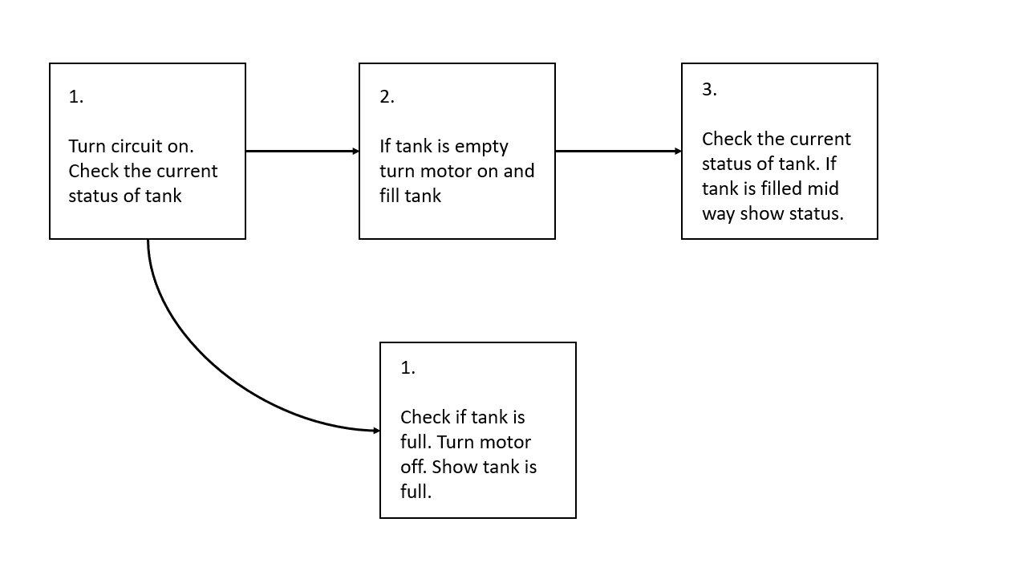
FLOW CHART

Slide 6
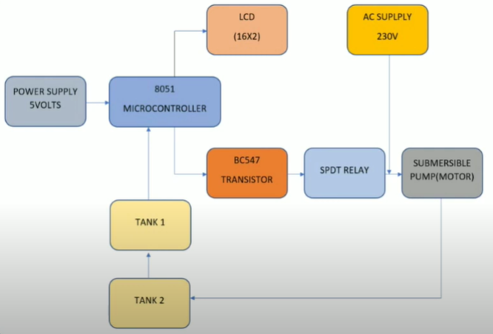
Block Diagram

Slide 7
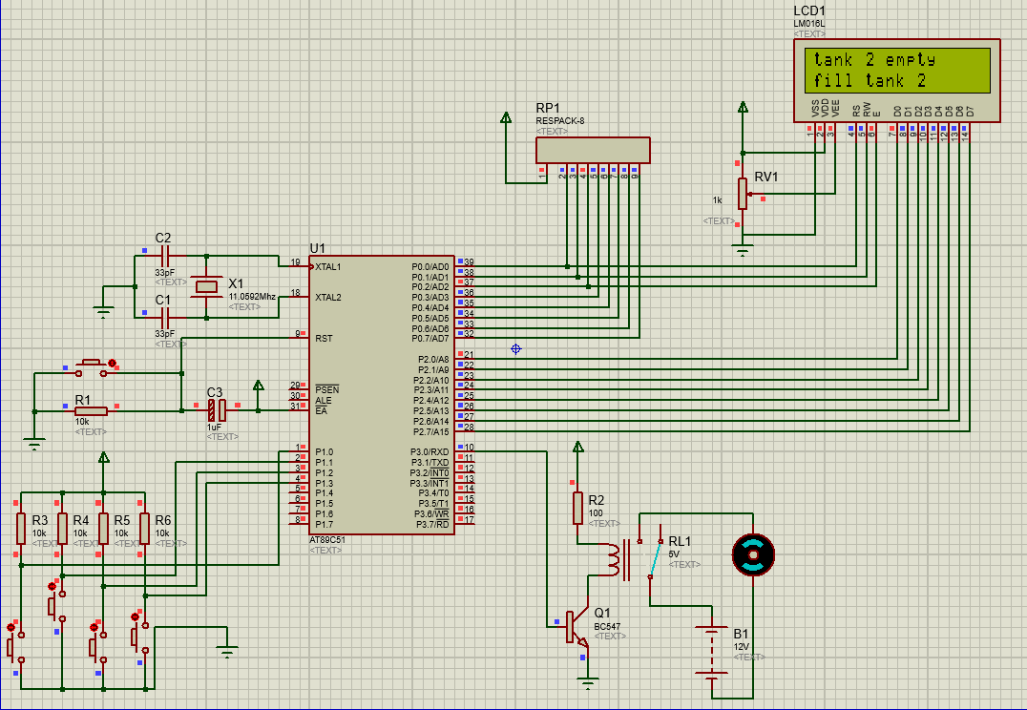
01
Condition 1:
The Tank(tank 2) from the ground which will be used to fill up the other tank is empty

Slide 8
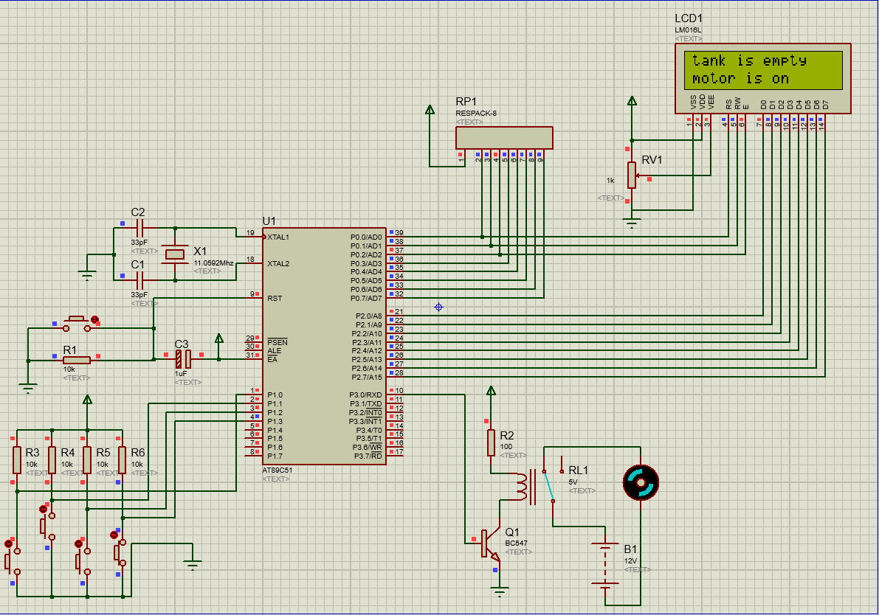
02
Condition 2:
The Tank(tank 2) from the ground is being filled up, by the motor. Motor is seen to be moving.

Slide 9
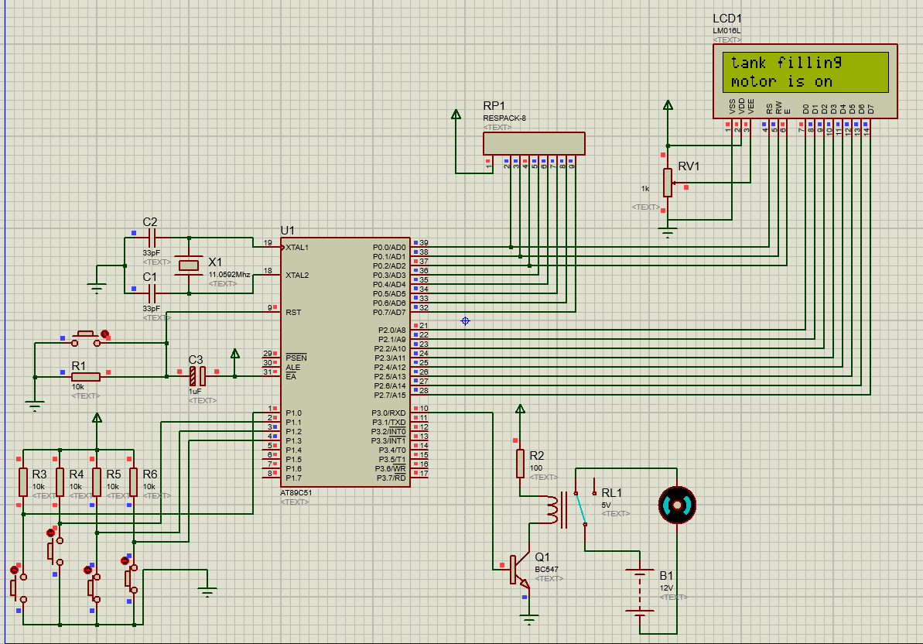
03
Condition 3:
Now the new tank to to be filled is filling up. The motor is moving.

Slide 10
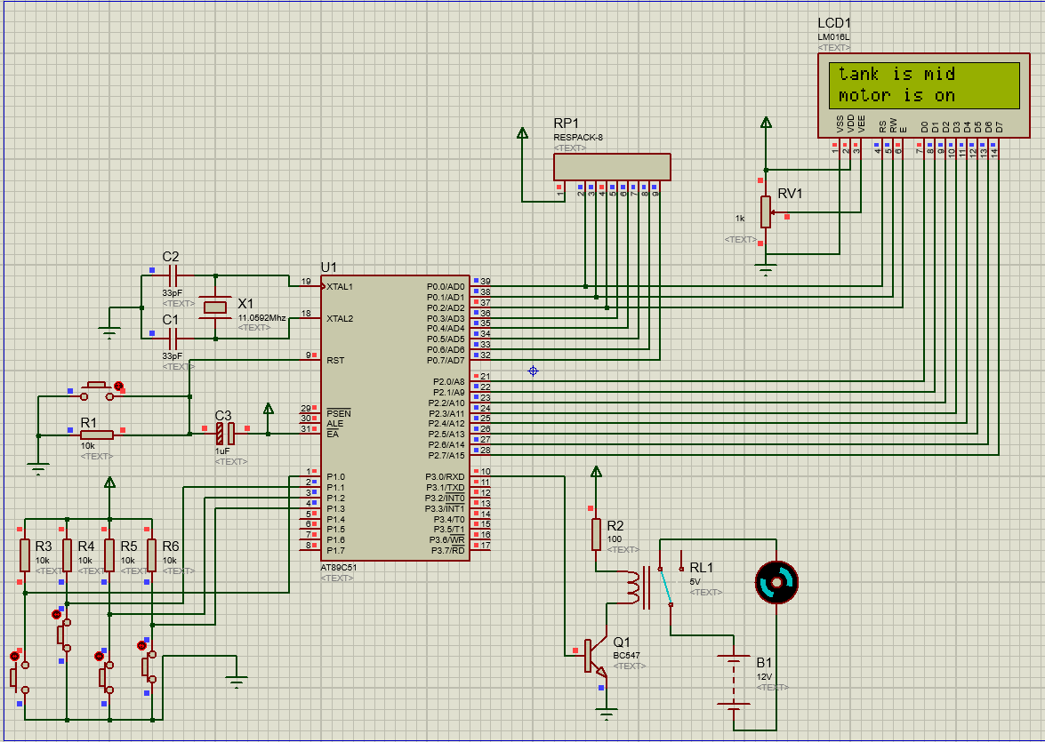
04
Condition 4:
The new tank is filled up till the mid way. The motor is still moving to fill up the tank more.

Slide 11
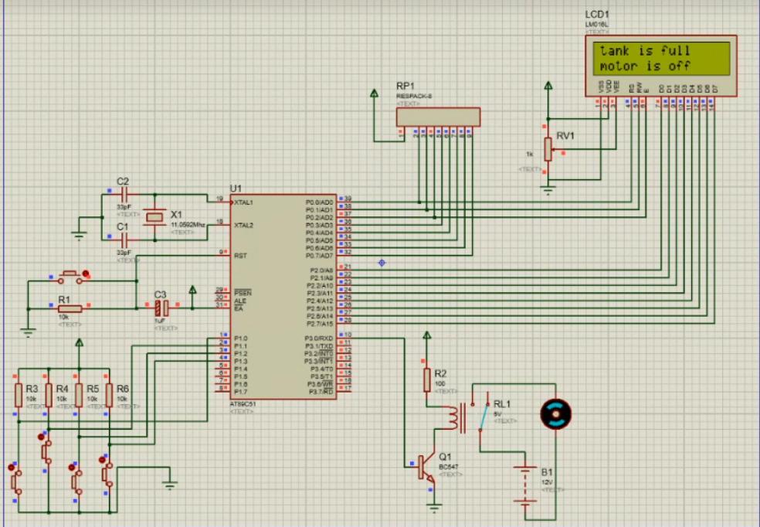
05
Condition 5:
The new tank is filled up completely.

Slide 12
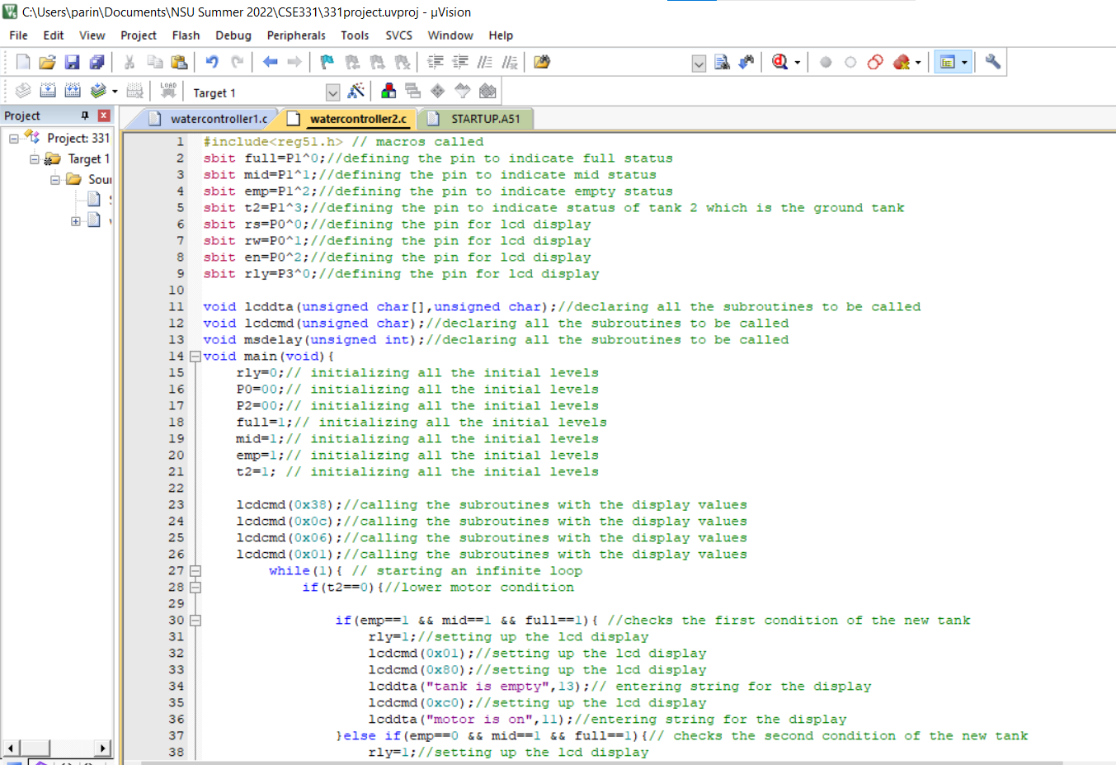
CODE SNIPPETS

Slide 13
THANKS!

